Slide 2
Fractions, Percentiles, and Decimals

Slide 3
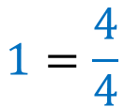
What is a fraction?
0 1
$$1=\frac{4}{4}$$

Slide 4

What is a fraction?
0 1
$$\frac{1}{4}$$

Slide 5
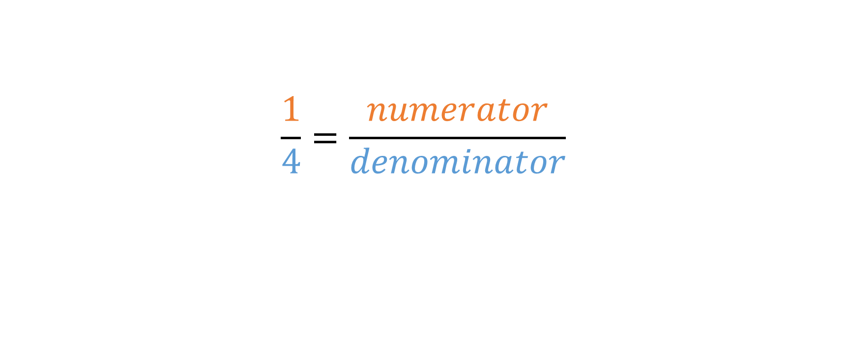
Fraction Terminology
$$\frac{1}{4}=\frac{numerator}{denominator}$$

Slide 6
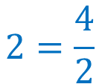

What is a fraction?
$$2=\frac{4}{2}$$
$$\frac{3}{2}$$
0 1 2

Slide 7

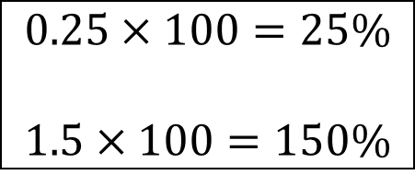

Related Concepts
$$\frac{1}{4}=25\%$$
$$\frac{3}{2}=150\%$$
$$\frac{1}{4}=0.25$$
$$\frac{3}{2}=1.5$$
Percentiles
Proportion
Ratio
Rate
Decimals
$$0.25×100=25\%$$
$$1.5×100=150\%$$

Slide 8
Exercise: Representing Fractions
What percent of the square is shaded red?

Slide 9
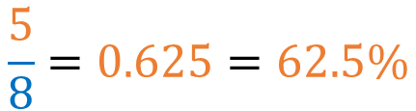
Solution: Representing Fractions
What percent of the square is shaded red?
$$\frac{5}{8}=0.625=62.5\%$$

Slide 10
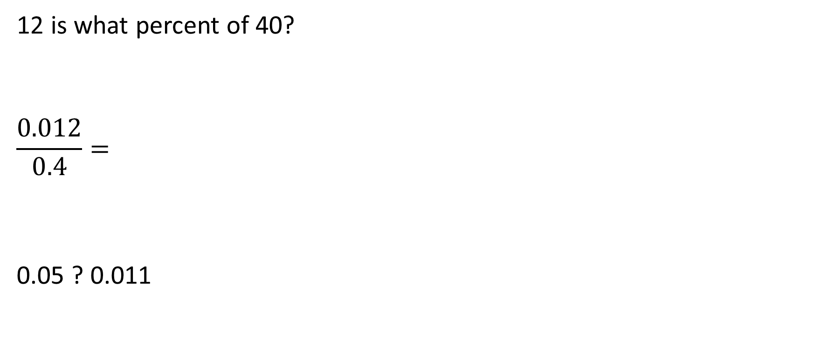
Exercise: Percentiles and Decimals
12 is what percent of 40?
$$\frac{0.012}{0.4}=$$
0.05 ? 0.011

Slide 11
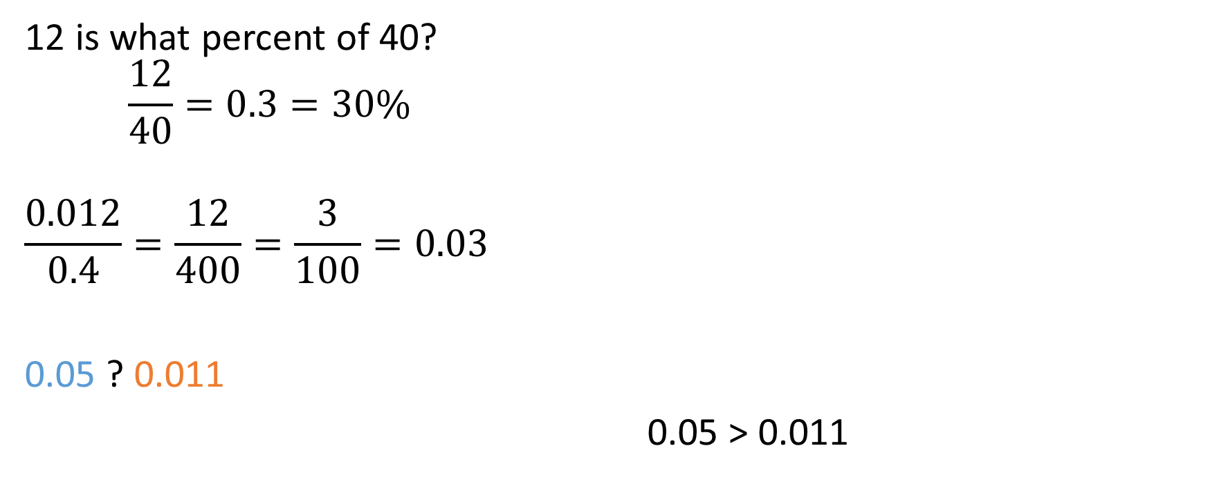
Solution: Percentiles and Decimals
12 is what percent of 40?
$$\frac{12}{40}=0.3=30\%$$
$$\frac{0.012}{0.4}=\frac{12}{400}=\frac{3}{100}=0.03$$
0.05 ? 0.011
0.05 > 0.011
0 0.1

Slide 12
Manipulating Fractions
Addition/subtraction: Denominators must match, perform operation on numerators
Multiplication/division: Numerator and denominator operate separately
Comparing: Matching denominators will simplify

Slide 13
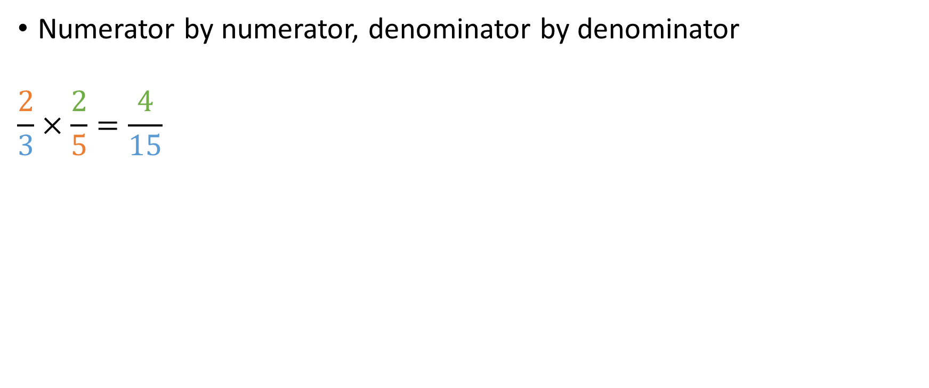
Multiplying Fractions
Numerator by numerator, denominator by denominator
$$\frac{2}{3}×\frac{2}{5}=\frac{4}{15}$$

Slide 14
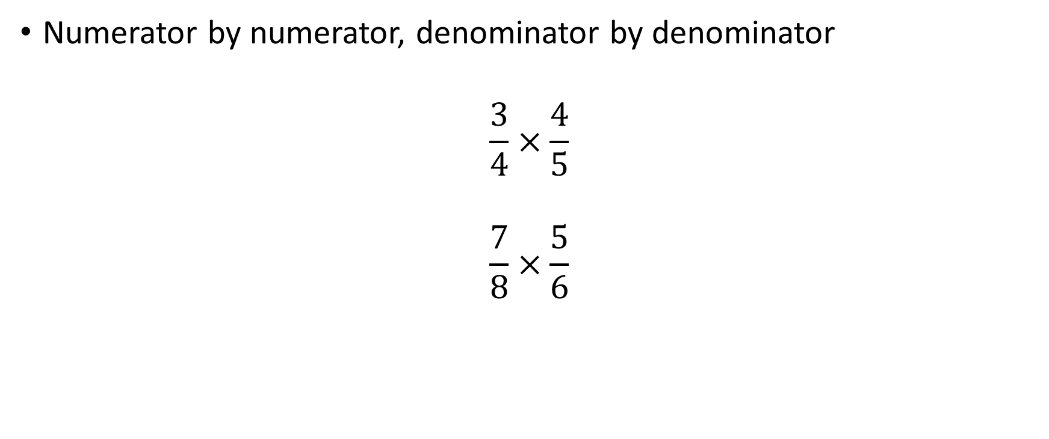
Exercise: Multiplying Fractions
Numerator by numerator, denominator by denominator
$$\frac{3}{4}×\frac{4}{5}$$
$$\frac{7}{8}×\frac{5}{6}$$

Slide 15
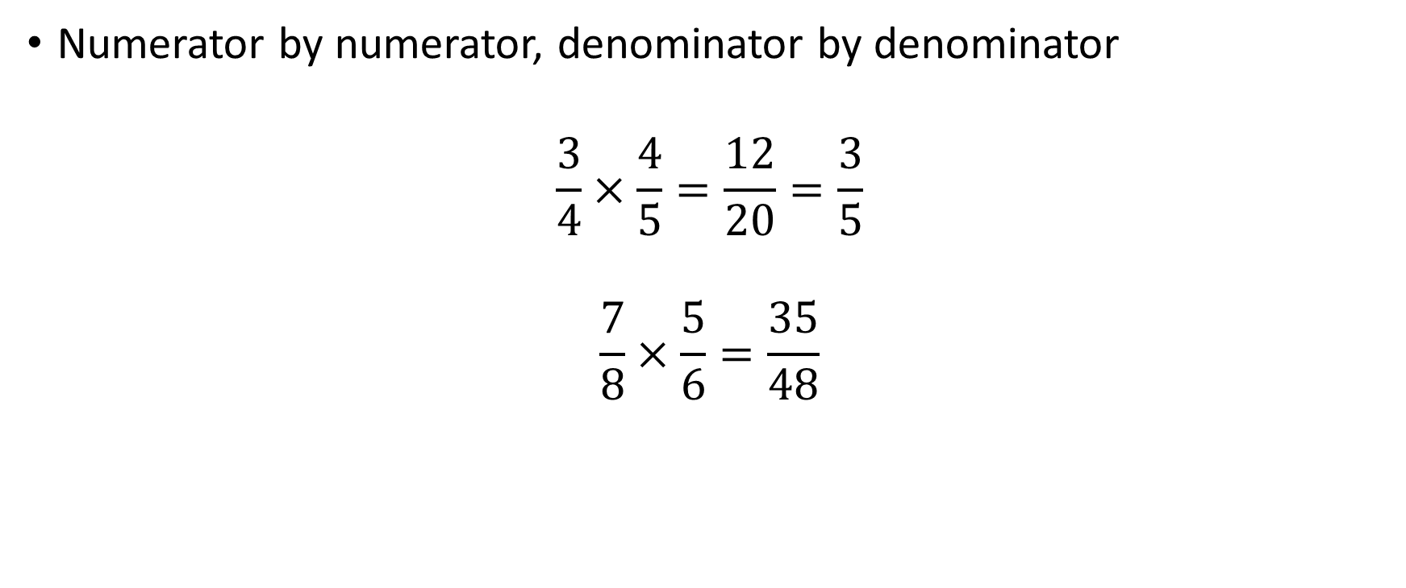
Solution: Multiplying Fractions
Numerator by numerator, denominator by denominator
$$\frac{3}{4}×\frac{4}{5}=\frac{12}{20}=\frac{3}{5}$$
$$\frac{7}{8}×\frac{5}{6}=\frac{35}{48}$$
or cross-cancel!
Notes:
Note the possibility of cross-canceling

Slide 16
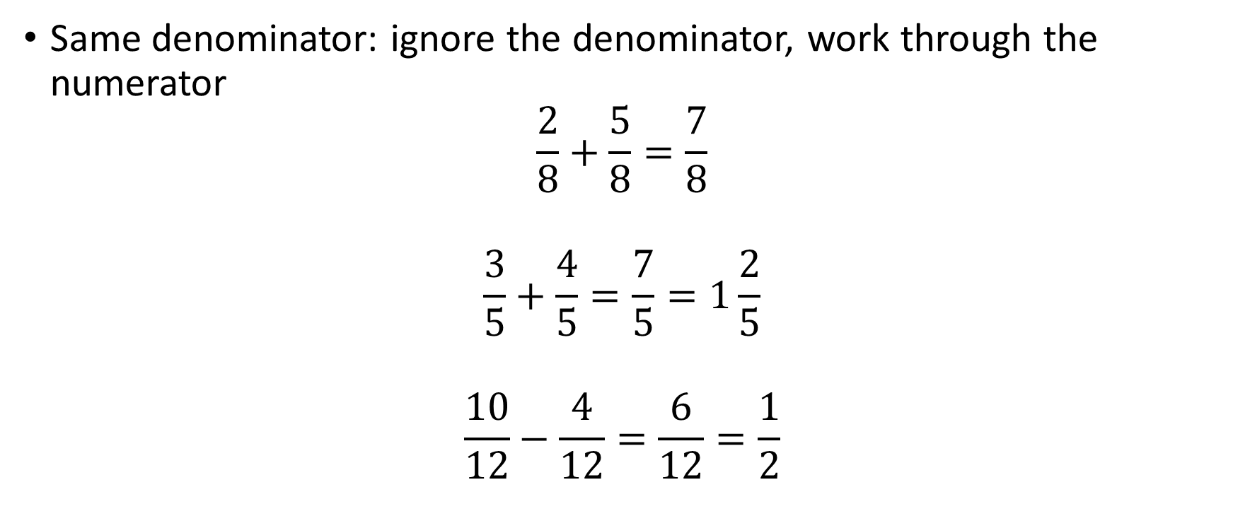
Adding/Subtracting Fractions
Same denominator: ignore the denominator, work through the numerator
$$\frac{2}{8}+\frac{5}{8}=\frac{7}{8}$$
$$\frac{3}{5}+\frac{4}{5}=\frac{7}{5}=1\frac{2}{5}$$
$$\frac{10}{12}−\frac{4}{12}=\frac{6}{12}=\frac{1}{2}$$

Slide 17
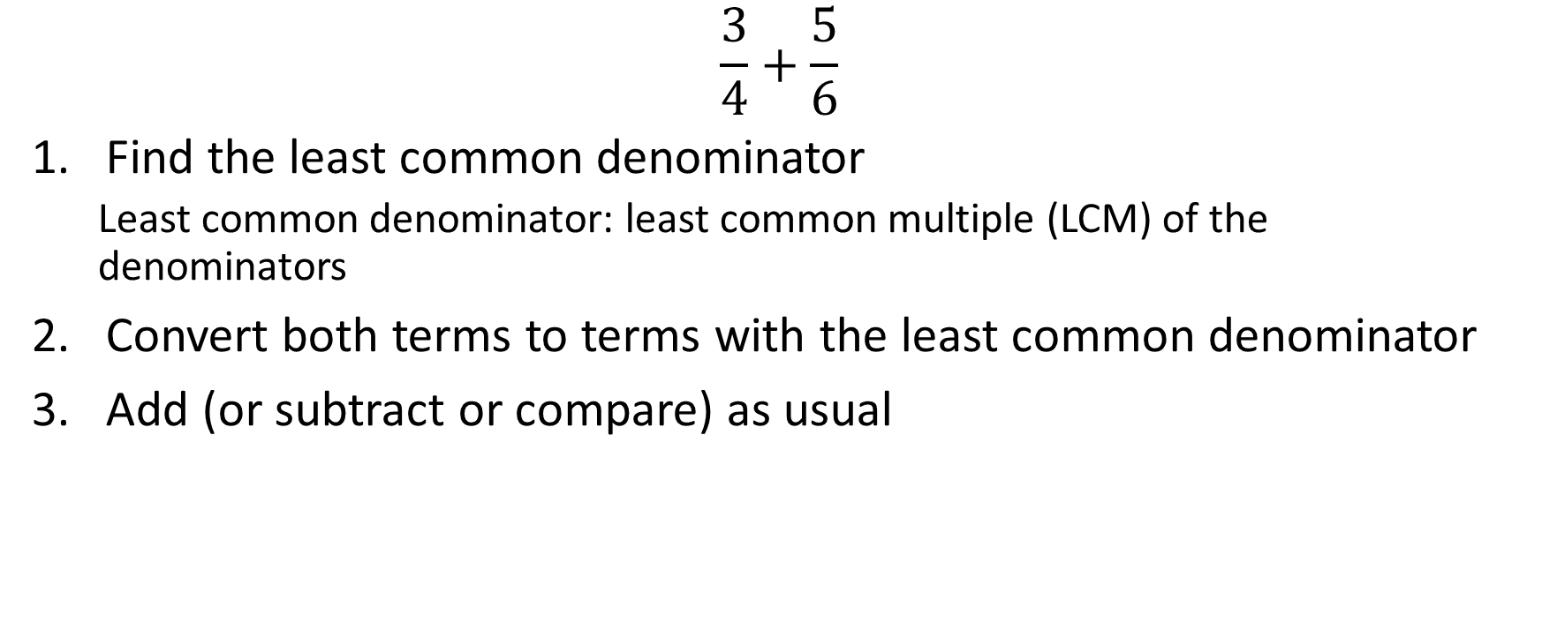
Adding/Subtracting Fractions: Different Denominators
$$\frac{3}{4}+\frac{5}{6}$$
Find the least common denominator
Least common denominator: least common multiple (LCM) of the denominators
Convert both terms to terms with the least common denominator
Add (or subtract or compare) as usual

Slide 18

Adding/Subtracting Fractions: Different Denominators
Find the least common denominator
$$\frac{3}{4}+\frac{5}{6}$$
Denominators: 4, 6
Least Common Multiple
4: 4, 8, 12, 16, 20, 24, 28…
6: 6, 12, 18, 24, 30…
Notes:
If you know how to use prime factorization, that’s also an easy way to do this.

Slide 19



Adding/Subtracting Fractions: Different Denominators
Convert both terms to terms with the least common denominator
$$\frac{3}{4}=\frac{?}{12} \frac{5}{6}=\frac{?}{12}$$
$$\frac{3}{4}×\frac{3}{3}=\frac{9}{12} \frac{5}{6}×\frac{2}{2}=\frac{10}{12}$$
$$×3$$
$$×3$$

Slide 20

Adding/Subtracting Fractions: Different Denominators
Add as usual
$$\frac{9}{12}+\frac{10}{12}=\frac{19}{12}=1\frac{7}{12}$$

Slide 21

Examples: Adding/Subtracting Fractions
$$\frac{3}{7}+\frac{2}{3}$$
$$−\frac{3}{7}−(−\frac{1}{4})$$

Slide 22

Example: Adding/Subtracting Fractions
$$\frac{3}{7}+\frac{2}{3}$$
Find the least common denominator
7: 7, 14, 21, 28…
3: 3, 6, 9, 12, 15, 18, 21, 24…
Convert to the least common denominator
$$\frac{3}{7}×\frac{3}{3}=\frac{9}{21} \frac{2}{3}×\frac{7}{7}=\frac{14}{21}$$
Add as usual
$$\frac{9}{21}+\frac{14}{21}=\frac{23}{21}=1.095$$
Notes:
Rounding to 1.1 here is not terrible—arguments both ways. However, rounding to 24/21 is really not OK.

Slide 23
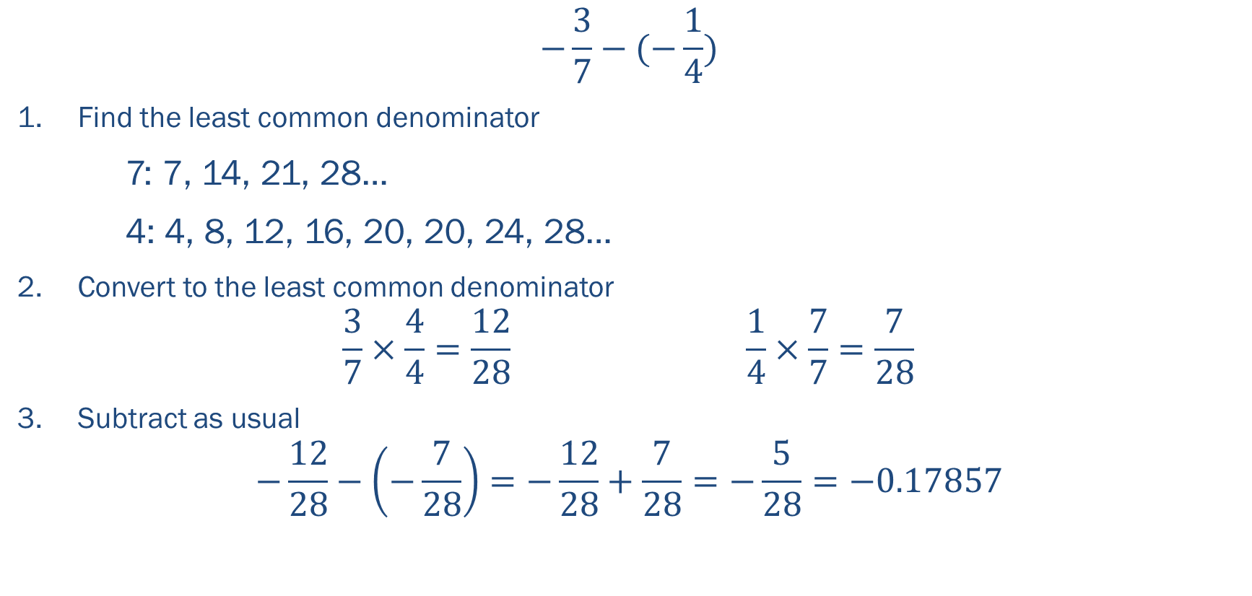
Example: Adding/Subtracting Fractions
$$−\frac{3}{7}−(−\frac{1}{4})$$
Find the least common denominator
7: 7, 14, 21, 28…
4: 4, 8, 12, 16, 20, 20, 24, 28…
Convert to the least common denominator
$$\frac{3}{7}×\frac{4}{4}=\frac{12}{28} \frac{1}{4}×\frac{7}{7}=\frac{7}{28}$$
Subtract as usual
$$−\frac{12}{28}−\left(−\frac{7}{28}\right)=−\frac{12}{28}+\frac{7}{28}=−\frac{5}{28}=−0.17857$$

Slide 24

Exercise: Adding/Subtracting Fractions
$$1\frac{1}{3}−\frac{2}{3}$$
$$\frac{1}{6} ? \frac{2}{9}$$
$$\frac{3}{4}−\frac{1}{3}$$

Slide 25

Solution: Adding/Subtracting Fractions
$$1\frac{1}{3}−\frac{2}{3}$$
$$=\frac{4}{3}−\frac{2}{3}$$
$$=\frac{2}{3}$$

Slide 26

Solution: Adding/Subtracting Fractions
$$\frac{1}{6}?\frac{2}{9}$$
Find the least common denominator
6: 6, 12, 18, 24, 30…
9: 9, 18, 27, 36…
Convert to the least common denominator
$$\frac{1}{6}×\frac{3}{3}=\frac{3}{18} \frac{2}{9}×\frac{2}{2}=\frac{4}{18}$$
Compare as usual
$$\frac{3}{18}?\frac{4}{18}$$
$$\frac{3}{18}<\frac{4}{18}$$

Slide 27
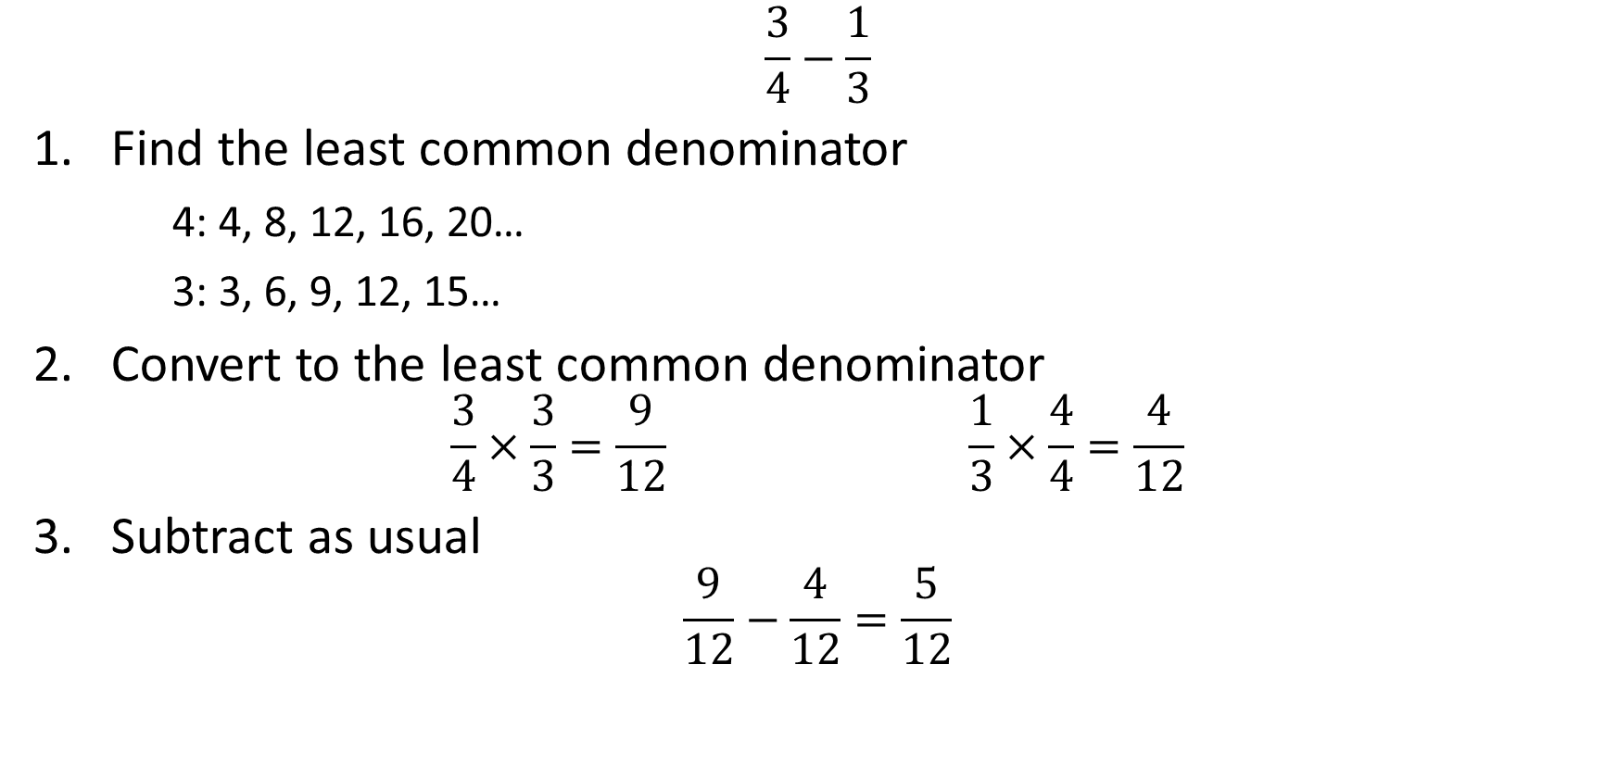
Solution: Adding/Subtracting Fractions
$$\frac{3}{4}−\frac{1}{3}$$
Find the least common denominator
4: 4, 8, 12, 16, 20…
3: 3, 6, 9, 12, 15…
Convert to the least common denominator
$$\frac{3}{4}×\frac{3}{3}=\frac{9}{12} \frac{1}{3}×\frac{4}{4}=\frac{4}{12}$$
Subtract as usual
$$\frac{9}{12}−\frac{4}{12}=\frac{5}{12}$$

Slide 28

Dividing Fractions
Multiply by the reciprocal
$$\frac{\frac{4}{5}}{\frac{2}{3}}=\frac{4}{5}÷\frac{2}{3}$$
$$=\frac{4}{5}×\frac{3}{2}$$
$$=\frac{12}{10}=1\frac{1}{5}$$

Slide 29

Exercise: Dividing Fractions
$$\frac{\frac{14}{100}}{\frac{3}{200}}$$

Slide 30

Solution: Dividing Fractions
$$\frac{\frac{14}{100}}{\frac{3}{200}}$$
$$=\frac{14}{100}×\frac{200}{3}$$
$$=\frac{2800}{300}$$
$$=7$$

Slide 31

Important Fraction Reminder
$$\frac{3}{4}+\frac{5}{6}≠\frac{3+5}{4+6}$$
$$1\frac{7}{12}≠\frac{8}{10}$$
$$\frac{3}{4a}+\frac{4}{5b}≠\frac{7}{4a+5b}$$
$$X/Y+X/Z≠X/{(Y+Z)}$$

Slide 32
Common Uses of Fractions in Epidemiology
Proportion: a part, share, or number considered in comparative relation to a whole
Example: proportion of deaths due to heart disease, 23.5%
Ratio: the quantitative relation between two amounts showing the number of times one value contains or is contained within the other
Example: sex ratio at age ≥60, 81 males:100 females
Rate: a measure, quantity, or frequency, typically one measured against some other quantity or measure
Example: mortality rate of heart disease, 193 per 100,000 person-years
Notes:
Another way to think about ratios is the comparison of two parts of a whole.
The critical thing to remember about rates is that there is some element of time

Slide 33
Algebra
Notes:
Relevance: foundation of regression equations, useful tool when breaking down problems
Disclaimer: we’re not re-teaching algebra, we’re just highlighting the useful pieces

Slide 34

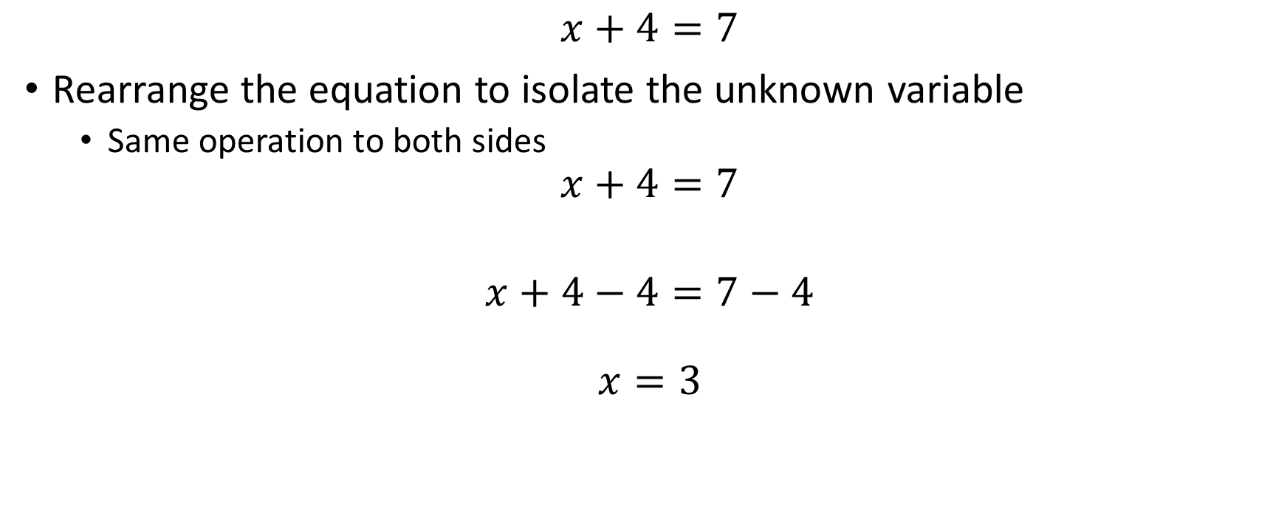

Solving for Unknown Quantity
$$x+4=7$$
Rearrange the equation to isolate the unknown variable
Same operation to both sides
$$x+4=7$$
$$x+4−4=7−4$$
$$x=3$$
$$−4$$
$$−4$$

Slide 35



Solving for Unknown Quantity
$$3x=12$$
$$\frac{3x}{3}=\frac{12}{3}$$
$$x=4$$
$$/3$$
$$/3$$

Slide 36

Exercise: Unknown Quantity
$$x+5=12.7$$
$$\frac{38}{216}=\frac{x}{1,000}$$
$$5(3x−2)=35$$
$$\frac{3}{x}=6$$
$${4x}^{2}=100$$

Slide 37
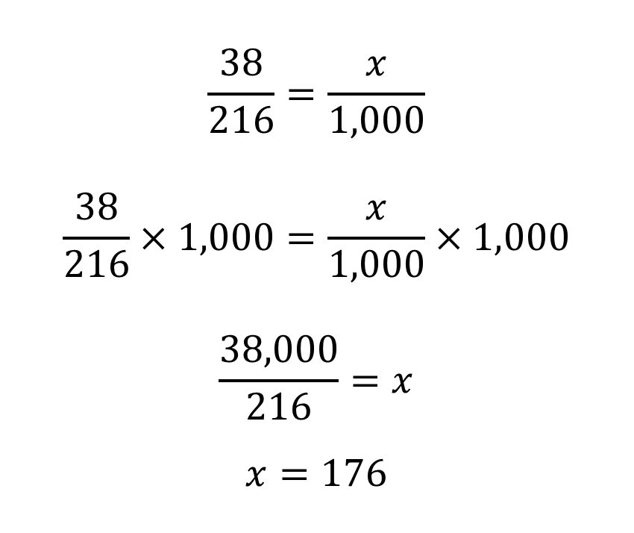

Solution: Unknown Quantity
$$x+5=12.7$$
$$x+5−5=12.7−5$$
$$x=7.7$$
$$\frac{38}{216}=\frac{x}{1,000}$$
$$\frac{38}{216}×1,000=\frac{x}{1,000}×1,000$$
$$\frac{38,000}{216}=x$$
$$x=176$$

Slide 38


Solution: Unknown Quantity
$$5(3x−2)=35$$
$$\frac{5(3x−2)}{5}=\frac{35}{5}$$
$$3x−2=7$$
$$3x−2+2=7+2$$
$$3x=9$$
$$\frac{3x}{3}=\frac{9}{3}$$
$$x=3$$
$$\frac{3}{x}=6$$
$$\frac{3}{x}∗x=6∗x$$
$$3=6x$$
$$\frac{3}{6}=x$$
$$0.5=x$$

Slide 39
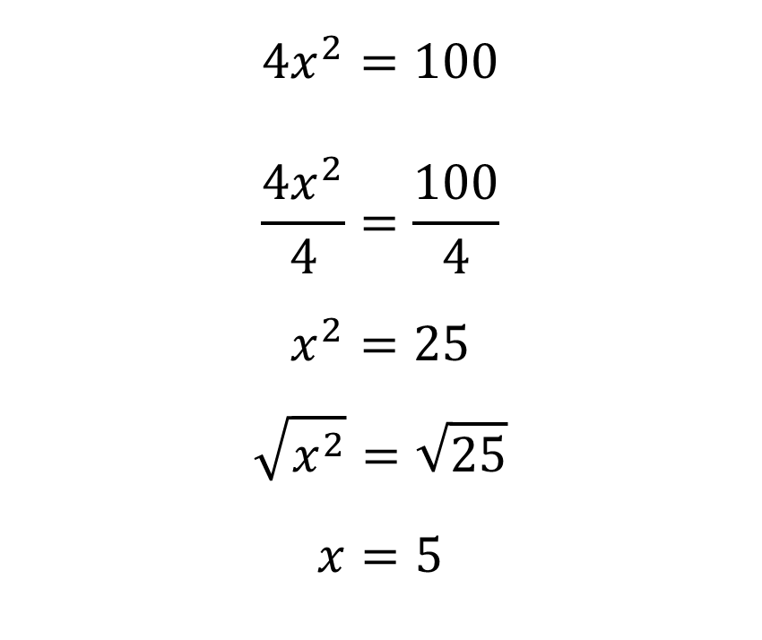
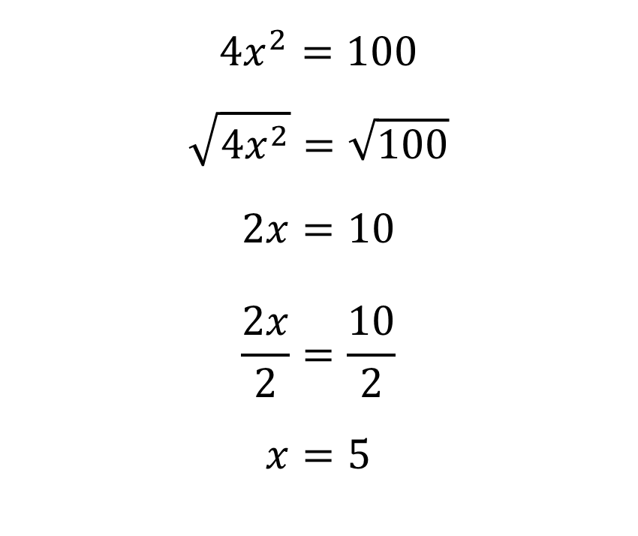
Solution: Unknown Quantity
$${4x}^{2}=100$$
$$\sqrt{{4x}^{2}}=\sqrt{100}$$
$$2x=10$$
$$\frac{2x}{2}=\frac{10}{2}$$
$$x=5$$
$${4x}^{2}=100$$
$$\frac{4x^{2}}{4}=\frac{100}{4}$$
$$x^{2}=25$$
$$\sqrt{x^{2}}=\sqrt{25}$$
$$x=5$$

Slide 40
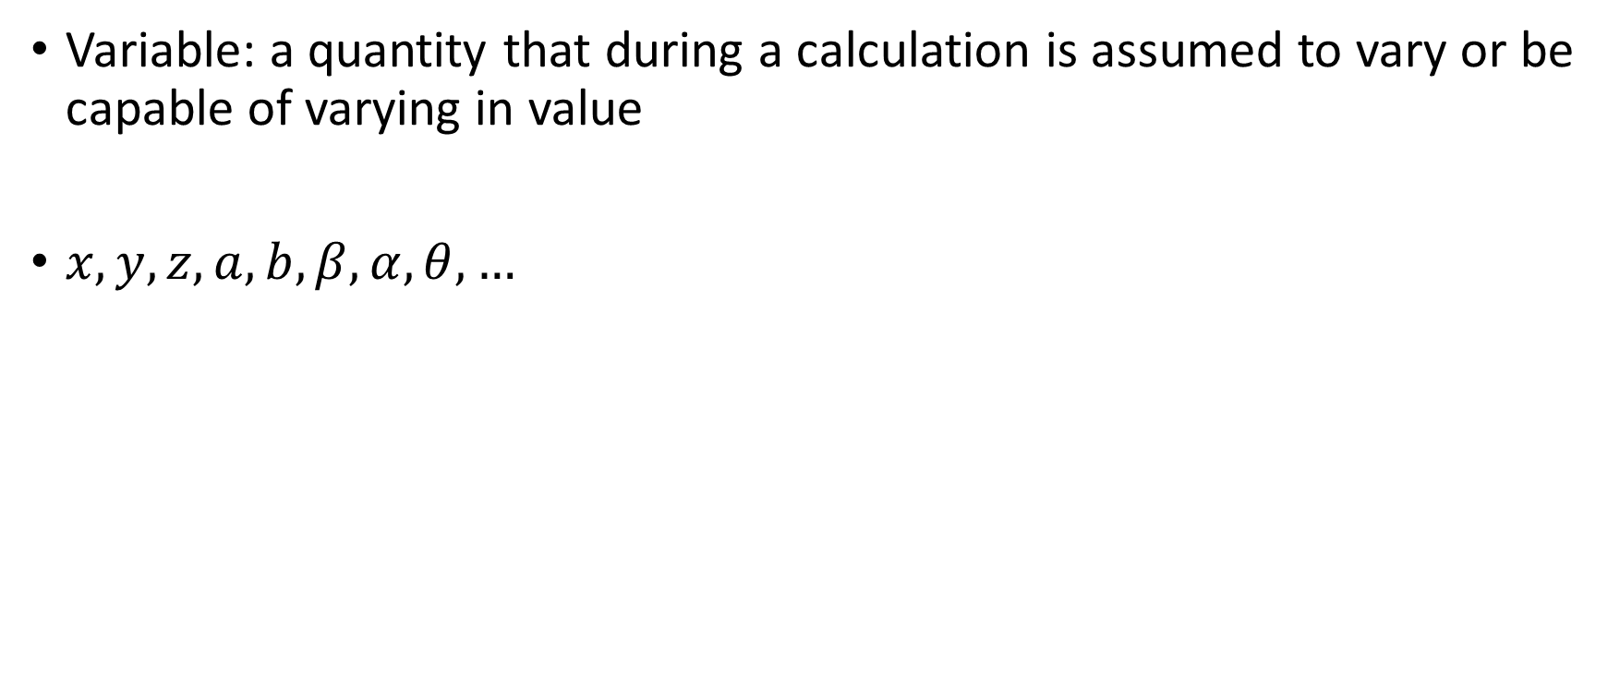
Variables
Variable: a quantity that during a calculation is assumed to vary or be capable of varying in value
$x, y, z, a, b, β, α, θ,…$

Slide 41
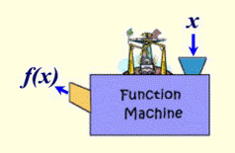

Function Notation
$$y=4x−3$$
$$f\left(x\right)=4x−3$$
$$g\left(x\right)=2x−1$$
$$h\left(x\right)=5x−6$$
Image: http://www.regentsprep.org/, 2016

Slide 42
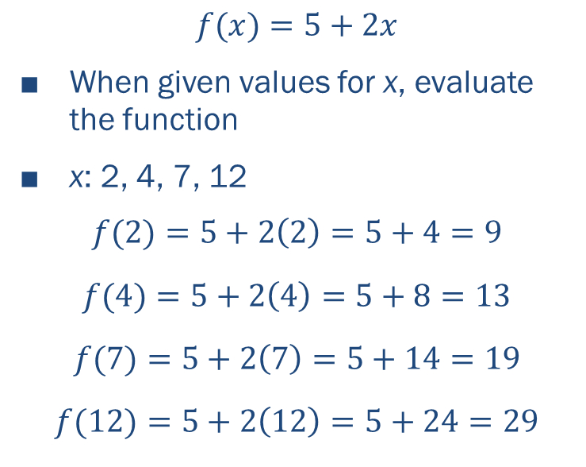
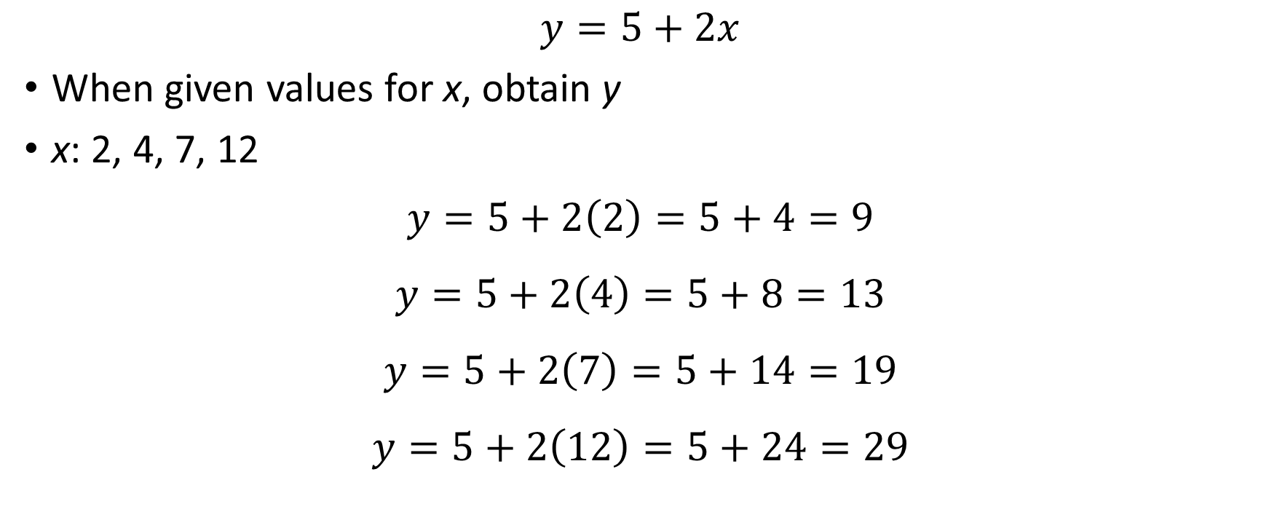
Evaluating Algebraic Equations
$$y=5+2x$$
When given values for x, obtain y
x: 2, 4, 7, 12
$$y=5+2\left(2\right)=5+4=9$$
$$y=5+2\left(4\right)=5+8=13$$
$$y=5+2\left(7\right)=5+14=19$$
$$y=5+2\left(12\right)=5+24=29$$
$$f(x)=5+2x$$
When given values for x, evaluate the function
x: 2, 4, 7, 12
$$f(2)=5+2\left(2\right)=5+4=9$$
$$f(4)=5+2\left(4\right)=5+8=13$$
$$f(7)=5+2\left(7\right)=5+14=19$$
$$f(12)=5+2\left(12\right)=5+24=29$$

Slide 43

Exercise: Evaluating Expressions
Evaluate $y=\frac{2}{3}α+4β$ for $α=5$ and $β=2$.
If $f\left(x\right)=x^{2}−x+2$, then $f(5)=$…
Given $f\left(x\right)=x^{2}−x+2$, evaluate $f(2a)$.

Slide 44

Solution: Evaluating Expressions
Evaluate $y=\frac{2}{3}α+4β$ for $α=5$ and $β=2$.
$$y=\frac{2}{3}\left(5\right)+4\left(2\right)$$
$$y=\frac{10}{3}+8=\frac{10}{3}+\frac{24}{3}=\frac{34}{3}$$
$$y=11\frac{1}{3}=11.333$$

Slide 45

Solution: Evaluating Expressions
If $f\left(x\right)=x^{2}−x+2$, then $f(5)=$…
$$f\left(5\right)=5^{2}−5+2$$
$$f\left(5\right)=25−5+2$$
$$f\left(5\right)=22$$

Slide 46

Solution: Evaluating Expressions
Given $f\left(x\right)=x^{2}−x+2$, evaluate $f(2a)$.
$$f\left(2a\right)={(2a)}^{2}−2a+2$$
$$f\left(2a\right)={4a}^{2}−2a+2$$

Slide 47
Weighted Averages

Slide 48
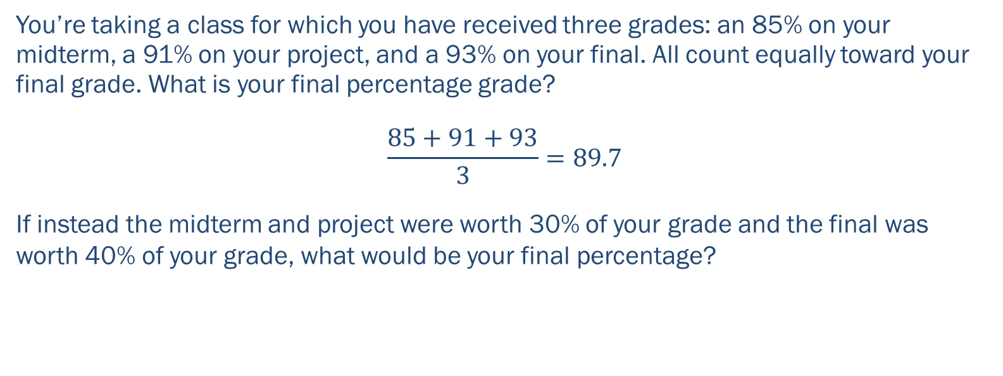
Average vs. Weighted Average
You’re taking a class for which you have received three grades: an 85% on your midterm, a 91% on your project, and a 93% on your final. All count equally toward your final grade. What is your final percentage grade?
$$\frac{85+91+93}{3}=89.7$$
If instead the midterm and project were worth 30% of your grade and the final was worth 40% of your grade, what would be your final percentage?

Slide 49


Average vs. Weighted Average
Average
Weighted Average
$$\frac{85+91+93}{3}=89.7$$
$$\frac{1}{3}×85+\frac{1}{3}×91+\frac{1}{3}×93=89.7$$
$$\frac{3}{10}×85+\frac{3}{10}×91+\frac{4}{10}×93=90$$

Slide 50
Exercise: Weighted Average
For a particular disease, 80% of cases are among children <10-years-old. Among these children, the risk of experiencing serious sequelae is 15%. In older children and adults, the risk of serious sequelae is only 5%. What is the risk of serious sequelae overall for all ages?

Slide 51

Solution: Weighted Average
For a particular disease, 80% of cases are among children <10-years-old. Among these children, the risk of experiencing serious sequelae is 15%. In older children and adults, the risk of serious sequelae is only 5%. What is the risk of serious sequelae overall for all ages?
$$\frac{8}{10}×0.15+\frac{2}{10}×0.05=0.13=13\%$$

Slide 52
Solving Word Problems

Slide 53
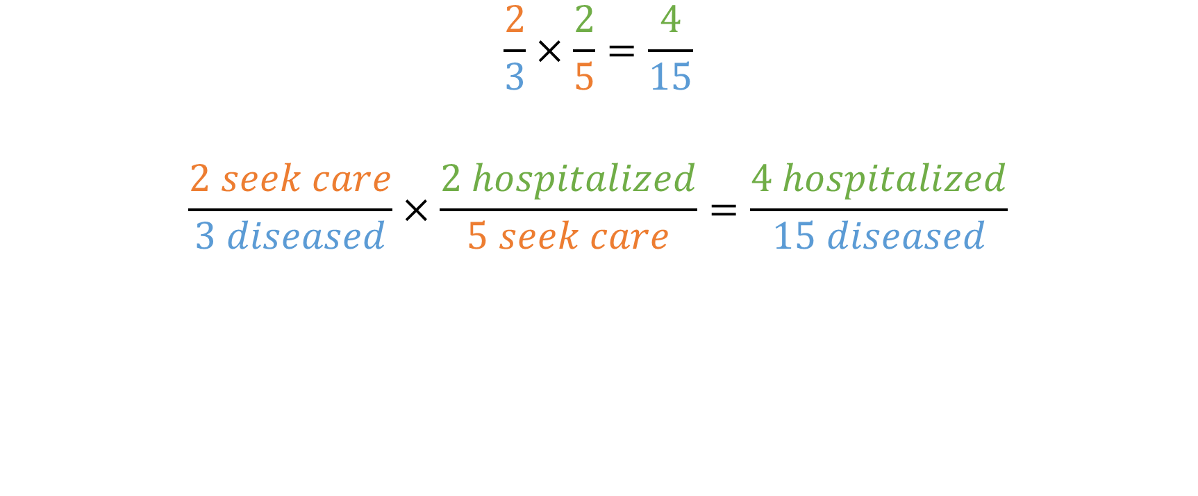
Using Units
$$\frac{2}{3}×\frac{2}{5}=\frac{4}{15}$$
$$\frac{2 seek care}{3 diseased}×\frac{2 hospitalized}{5 seek care}=\frac{4 hospitalized}{15 diseased}$$

Slide 54

Using Units
$$\frac{\frac{14 diseased}{100 at risk}}{\frac{3 diseased}{200 at risk}}$$
$$=\frac{14 diseased}{100 at risk}×\frac{200 at risk}{3 diseased}$$
$$=\frac{2800}{300}$$
$$=7$$

Slide 55

Using Units
$$\frac{38 dead}{216 ill}=\frac{x }{1,000 ill}$$
$$\frac{38 dead}{216 ill}×1,000 ill=\frac{x}{1,000 ill}×1,000 ill$$
$$\frac{38,000}{216}dead=x$$
$$x=176 dead$$

Slide 56
Problem Solving
Read the whole problem
Identify the question
Break down the quantity being asked for
Identify useful information
Review remaining information
Calculate
Reflect on your answer
Concept
Formula
Answer
Equation
Notes:
#3 is where we depart from standard elementary school processes for solving word problems
#7 is important in case you mess up so badly on #6 that it calls into question your understanding of the concept

Slide 57
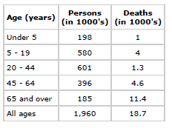
Example: Word Problem
In a population of 500,000 how many deaths would you expect in a year?
Average annual deaths in a population

Slide 58
Example: Word Problem
In a population of 500,000 how many deaths would you expect in a year?
Read the whole problem
Identify the question
Break down the quantity being asked for
Expected deaths in a year
Identify useful information
Review remaining information
Calculate
(18.7/1,960)*500,000
Reflect on your answer
Average annual deaths in a population

Slide 59
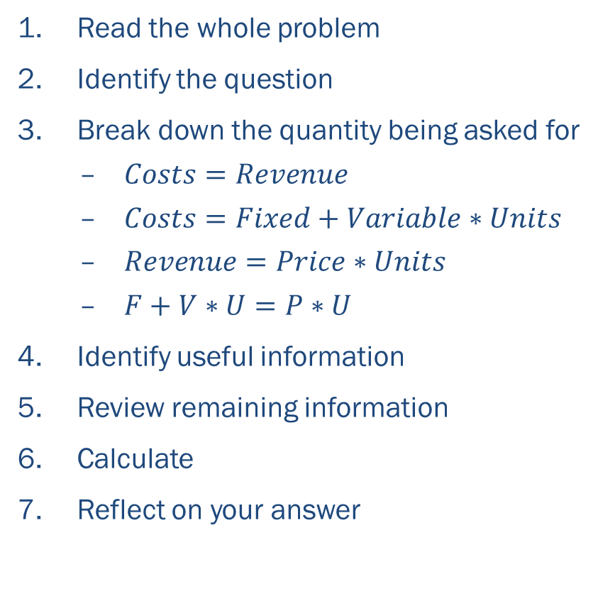
Example: Word Problem
A manufacturer sells products for $5 per unit. Some retailers add $1 per unit to the price for consumers. Fixed costs are constant at $3,000 regardless of the number of units of product involved. Total cost is equal to the sum of fixed costs and variable costs. In this company, variable costs are estimated to be $2 per unit. What is the breakeven point (i.e. how many units must be sold so that the total costs equal total revenues)?
Read the whole problem
Identify the question
Break down the quantity being asked for
$Costs=Revenue$
$Costs=Fixed+Variable∗Units$
$Revenue=Price∗Units$
$F+V∗U=P∗U$
Identify useful information
Review remaining information
Calculate
Reflect on your answer

Slide 60

Example: Word Problem
A manufacturer sells products for $5 per unit. Some retailers add $1 per unit to the price for consumers. Fixed costs are constant at $3,000 regardless of the number of units of product involved. Total cost is equal to the sum of fixed costs and variable costs. In this company, variable costs are estimated to be $2 per unit. What is the breakeven point (i.e. how many units must be sold so that the total costs equal total revenues)?
Read the whole problem
Identify the question
Break down the quantity being asked for
$F+V∗U=P∗U$
Identify useful information
$F=\$3,000$
$V=\$2$
$P=\$5$
Review remaining information
Calculate
$\$3,000+\$2U=\$5U$
Reflect on your answer

Slide 61

Example: Word Problem
A manufacturer sells products for $5 per unit. Some retailers add $1 per unit to the price for consumers. Fixed costs are constant at $3,000 regardless of the number of units of product involved. Total cost is equal to the sum of fixed costs and variable costs. In this company, variable costs are estimated to be $2 per unit. What is the breakeven point (i.e. how many units must be sold so that the total costs equal total revenues)?
Read the whole problem
Identify the question
Break down the quantity being asked for
Identify useful information
Review remaining information
Calculate
$\$3,000+\$2U=\$5U$
$\$3,000+\$2U−\$2U=\$5U−\$2U$
$\$3,000=\$3U$
$\frac{\$3,000}{\$3}=\frac{\$3U}{\$3}$
$1,000=U$
Reflect on your answer
Notes:
Reflecting on your answer: Does the quantity make sense? Do the units make sense?

Slide 62
Exercise: Word Problem
The following data were obtained for children 6 months through 4 years from the Second NHANES survey, conducted February 1976-February 1980, among 27,801 persons in the United States.
How many children examined with blood lead levels greater than or equal to 20 micrograms/deciliter had a history of eating unusual substances?
Blood lead level (micrograms/deciliter) | No. examined | % with history of eating unusual substances
≥30 | 117 | 16.2
20-29 | 503 | 14.1
<20 | 1,752 | 5.2
Adapted from Exercises in Epidemiology by Noel Weiss, 2012.

Slide 63

Solution: Word Problem
The following data were obtained for children 6 months through 4 years from the Second NHANES survey, conducted February 1976-February 1980, among 27,801 persons in the United States.
How many children examined with blood lead levels greater than or equal to 20 micrograms/deciliter had a history of eating unusual substances?
$$\#Eating=\#Examined∗\%Eating$$
$$\#{Eat}_{≥20}=\#{Eat}_{20−29}+\#{Eat}_{≥30}$$
$$\#{Eat}_{20−29}=\#{Ex}_{20−29}∗\%{Eat}_{20−29}$$
$$\#{Eat}_{≥30}=\#{Ex}_{≥30}∗\%{Eat}_{≥30}$$
$$\#{Eat}_{≥20}=503∗0.141+117∗0.162$$
$$\#{Eat}_{≥20}=90$$
Blood lead level (micrograms/deciliter) | No. examined | % with history of eating unusual substances
≥30 | 117 | 16.2
20-29 | 503 | 14.1
<20 | 1,752 | 5.2
Adapted from Exercises in Epidemiology by Noel Weiss, 2012.
Notes:
Concept: manipulating percents

Slide 64
Exercise: Word Problem
The following data were obtained for children 6 months through 4 years from the Second NHANES survey, conducted February 1976-February 1980, among 27,801 persons in the United States.
What proportion of children examined had a history of eating unusual substances?
Blood lead level (micrograms/deciliter) | No. examined | % with history of eating unusual substances
≥30 | 117 | 16.2
20-29 | 503 | 14.1
<20 | 1,752 | 5.2
Adapted from Exercises in Epidemiology by Noel Weiss, 2012.

Slide 65

Solution: Word Problem
The following data were obtained for children 6 months through 4 years from the Second NHANES survey, conducted February 1976-February 1980, among 27,801 persons in the United States.
What proportion of children examined had a history of eating unusual substances?
$$\%{Eat}_{tot}=\frac{\#{Eat}_{tot}}{\#{Ex}_{tot}}$$
Blood lead level (micrograms/deciliter) | No. examined | % with history of eating unusual substances
≥30 | 117 | 16.2
20-29 | 503 | 14.1
<20 | 1,752 | 5.2
Adapted from Exercises in Epidemiology by Noel Weiss, 2012.
Notes:
Concept: weighted average

Slide 66


Solution: Word Problem
Blood lead level (micrograms/deciliter) | No. examined | % with history of eating unusual substances
≥30 | 117 | 16.2
20-29 | 503 | 14.1
<20 | 1,752 | 5.2
What proportion of children examined had a history of eating unusual substances?
$$\%{Eat}_{tot}=\frac{\#{Eat}_{tot}}{\#{Ex}_{tot}}$$
$$\#{Ex}_{tot}=\#{Ex}_{≥30}+\#{Ex}_{20−29}+\#{Ex}_{<20}=117+503+1752=2372$$
$$\%{Eat}_{tot}=\frac{\#{Ex}_{≥30}}{\#{Ex}_{tot}}\left(\%{Eat}_{≥30}\right)+\frac{\#{Ex}_{20−29}}{\#{Ex}_{tot}}\left(\%{Eat}_{20−29}\right)+\frac{\#{Ex}_{<20}}{\#{Ex}_{tot}}\left(\%{Eat}_{<20}\right)$$
$$\%{Eat}_{tot}=\frac{117}{2372}\left(0.162\right)+\frac{503}{2372}\left(0.141\right)+\frac{1752}{2372}\left(0.052\right)=0.076=7.6\%$$
Adapted from Exercises in Epidemiology by Noel Weiss, 2012.
Notes:
Concept: weighted average

Slide 67
Exercise: Word Problem
The following data were obtained for children 6 months through 4 years from the Second NHANES survey, conducted February 1976-February 1980, among 27,801 persons in the United States.
What proportion of children with a history of eating unusual substances had a blood lead level ≥30 micrograms/deciliter?
Blood lead level (micrograms/deciliter) | No. examined | % with history of eating unusual substances
≥30 | 117 | 16.2
20-29 | 503 | 14.1
<20 | 1,752 | 5.2
Adapted from Exercises in Epidemiology by Noel Weiss, 2012.

Slide 68

Solution: Word Problem
The following data were obtained for children 6 months through 4 years from the Second NHANES survey, conducted February 1976-February 1980, among 27,801 persons in the United States.
What proportion of children with a history of eating unusual substances had a blood lead level ≥30 micrograms/deciliter?
$$\%{Eat}_{≥30}=\frac{\#{Eat}_{≥30}}{\#{Eat}_{tot}}$$
Blood lead level (micrograms/deciliter) | No. examined | % with history of eating unusual substances
≥30 | 117 | 16.2
20-29 | 503 | 14.1
<20 | 1,752 | 5.2
Adapted from Exercises in Epidemiology by Noel Weiss, 2012.

Slide 69


Solution: Word Problem
Blood lead level (micrograms/deciliter) | No. examined | % with history of eating unusual substances
≥30 | 117 | 16.2
20-29 | 503 | 14.1
<20 | 1,752 | 5.2
What proportion of children with a history of eating unusual substances had a blood lead level ≥30 micrograms/deciliter?
$$\%{Eat}_{≥30}=\frac{\#{Eat}_{≥30}}{\#{Eat}_{tot}}$$
$$\%{Eat}_{≥30}=\frac{\#{Eat}_{≥30}}{\#{Eat}_{≥30}+\#{Eat}_{≥30}+\#{Eat}_{≥30}}=\frac{\#{Ex}_{≥30}\left(\%{Eat}_{≥30}\right)}{\#{Ex}_{≥30}\left(\%{Eat}_{≥30}\right)+\#{Ex}_{20−29}\left(\%{Eat}_{20−29}\right)+\#{Ex}_{<20}\left(\%{Eat}_{<20}\right)}=\frac{117\left(0.162\right)}{117\left(0.162\right)+503\left(0.141\right)+1752\left(0.052\right)}=0.105=10.5\%$$
Adapted from Exercises in Epidemiology by Noel Weiss, 2012.
Notes:
Concept: weighted average

Slide 70
Exercise: Word Problem
The following is from a newspaper article on seat belts:
Of the 649 people who died in traffic accidents in Washington last year, 55 percent were not wearing seat belts. In those same fatal crashes, 73 percent of people who were belted in survived without serious injury.
Can you identify the percent of people who survived these crashes without serious injury and were not belted in? If so, calculate it. If not, what quantity would you need to calculate this number?
Adapted from Exercises in Epidemiology by Noel Weiss, 2012.

Slide 71

Solution: Word Problem
The following is from a newspaper article on seat belts:
Of the 649 people who died in traffic accidents in Washington last year, 55 percent were not wearing seat belts. In those same fatal crashes, 73 percent of people who were belted in survived without serious injury.
Can you identify the percent of people who survived these crashes without serious injury and were not belted in? If so, calculate it. If not, what quantity would you need to calculate this number?
$$\frac{{Survived}_{not belted}}{{Survived}_{tot}}$$
Adapted from Exercises in Epidemiology by Noel Weiss, 2012.

Slide 72


Solution: Word Problem
Of the 649 people who died in traffic accidents in Washington last year, 55 percent were not wearing seat belts. In those same fatal crashes, 73 percent of people who were belted in survived without serious injury.
Can you identify the percent of people who survived these crashes without serious injury and were not belted in? If so, calculate it. If not, what quantity would you need to calculate this number?
$$\frac{{Survived}_{not belted}}{{Survived}_{tot}}$$
649 died- 55% not belted, 45% belted
$$\frac{{Died}_{not belted}}{{Died}_{tot}}=\frac{{Died}_{not belted}}{649}=0.55$$
X belted- 73% survived, 27% died
$$\frac{{Belted}_{surv}}{{Belted}_{tot}}=\frac{{Surv}_{belted}}{{Belted}_{tot}}=0.73$$
NOT ENOUGH INFORMATION
Adapted from Exercises in Epidemiology by Noel Weiss, 2012.

Slide 73
Exercise: Word Problem
The rate of suicide among American physicians, relative to the corresponding rate in the population as a whole, varies by gender. Among men, the rate in physicians is 1.5 times higher, whereas among women the corresponding relative rate is 3.0. It turns out that the rate of suicide in American male and female physicians is identical. For American men and women in general, what is the relative rate of suicide in men compared to women?
Taken from Exercises in Epidemiology by Noel Weiss, 2012.

Slide 74

Solution: Word Problem
The rate of suicide among American physicians, relative to the corresponding rate in the population as a whole, varies by gender. Among men, the rate in physicians is 1.5 times higher, whereas among women the corresponding relative rate is 3.0. It turns out that the rate of suicide in American male and female physicians is identical. For American men and women in general, what is the relative rate of suicide in men compared to women?
$$\frac{Suicide {Rate}_{American men}}{{Suicide Rate}_{American women}}$$
Taken from Exercises in Epidemiology by Noel Weiss, 2012.

Slide 75


Solution: Word Problem
The rate of suicide among American physicians, relative to the corresponding rate in the population as a whole, varies by gender. Among men, the rate in physicians is 1.5 times higher, whereas among women the corresponding relative rate is 3.0. It turns out that the rate of suicide in American male and female physicians is identical. For American men and women in general, what is the relative rate of suicide in men compared to women?
$$\frac{{Suicide Rate}_{American men}}{{Suicide Rate}_{American women}}$$
$$S_{P.M.}=S_{P.F.}=S_{P}$$
$$\frac{S_{P}}{S_{A.M.}}=1.5→S_{A.M.}=\frac{S_{P}}{1.5}$$
$$\frac{S_{P}}{S_{A.F.}}=3.0→S_{A.F.}=\frac{S_{P}}{3.0}$$
$$\frac{S_{A.M.}}{S_{A.F.}}=\frac{\frac{S_{P}}{1.5}}{\frac{S_{P}}{3.0}}=\frac{S_{P}}{1.5}×\frac{3.0}{S_{P}}=2$$
Taken from Exercises in Epidemiology by Noel Weiss, 2012.

